Slide 1


Port Infrastructure / ACCESS FEES & VBS Fee increases
How do NSW consumers continue to pay for these excessive increases?

Slide 2



Port Infrastructure/Access fees are sky rocketing
Since inception in 2017, DPW Infrastructure/Access Import fee has increased 430%, Patricks Infrastructure/Access Import fee by 350% and Hutchison Infrastructure/Access fee by 750% and have not seen any productivity gains
DP WORLD
INFRA-STRUCTURE / ACCESS Import Fee
430% Increase from Inception
$21.16 to $112.10
PATRICKS
INFRA-STRUCTURE / ACCESS IMPORT FEE
350% Increase from Inception
$25.45 to $114.50
HUTCHISON
INFRA-STRUCTURE / ACCESS FEES
750% Increase from Inception
$10.45 to $88.83

Slide 3

Port Infrastructure/Access fee increases are unsustainable
Since inception increases per container are annually or bi-annually on average $22 to $28 per container
The increasing Infrastructure/Access fee costs are unsustainable:
DP World recently increased their fee by $21.10 to $112.10 effective 8/5/2020, a 23% increase. This followed after only 4 months after their last increase in January of 43% to $91.
Patrick’s increased their infrastructure/access fee in March 2020 to $114.50 a $37 increase, up +48%. Hutchison has just increased their access fee effective 8/9/2020 by $25.72 to $88.83, a 41% increase on the $63.11 price increased on the 18/11/19. Hutchison has same fee for imports and exports.
DP World lowered their export fees to $79.5 effective 8/5/20 reducing the cost by 13% and $11.50 in recognition of COVID-19 effects on exporters. Patricks increased their export fee by $5, a 6% increase in comparison to the $37 increase for importers.
What infrastructure or better access have we received for these sky-rocketing increases? ……………..Zero?

Slide 4
VBS Booking fees are also increasing phenomenally
DPW VBS booking fee has increased 104% since inception, Patricks by 74% while Hutchison has remained the same since inception.
VBS Booking fees are continually increasing:
DP World has increased by 104% from $11.5 in April 2017 to $23.44 effective 2/1/2020. This is a 30% increase, up +$5.36 on the prior fee of $18.08.
Patricks has increased by 74% from $11.51 in July 2017 to $20 effective 9/3/2020. This is a 54% increase, up +$7 on the prior fee of $13.00.
Hutchison only introduced the fee of $12.00 in July 2018 but if their infrastructure/access fee increase of 750% is an indication of the next hike we could be paying as much as $90.

Slide 5
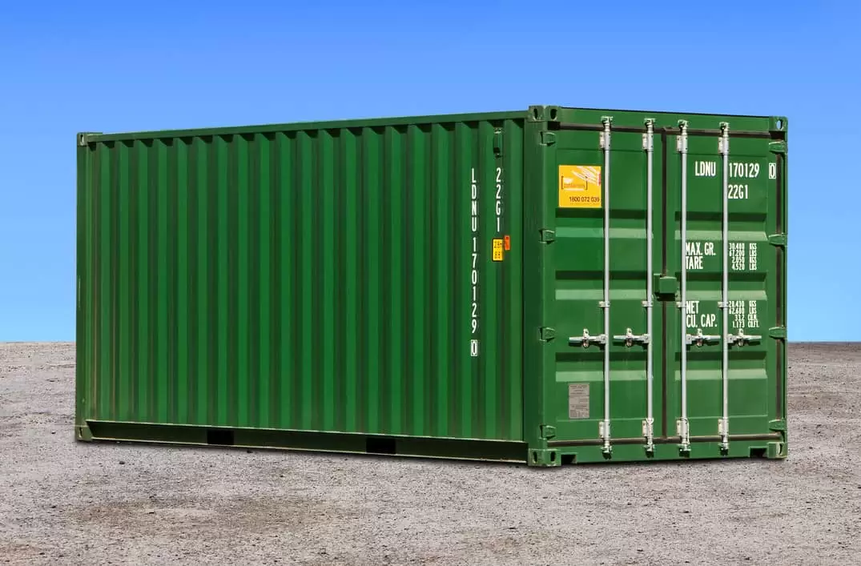
723% increased cost per container in 4 years
This increased cost per container is borne by the importer, exporter and ultimately the end consumer…when will it stop?
VBS, Infrastructure/ Access fee and Empty Yard fee has increased 723% from $20.17 FY16/17 per container to $165.99 per container in FY19/20.
A $145.82 increase per container!!!!
The cost of VBS, Infrastructure/Access fees and Empty Yard fees as a % of total Operating expenses has increased more than 6 times in 4 years. The financial year costs are a % of total operating expenses have been:
5% in June 2017
10% in June 2018
16% in June 2019
33.14% in June 2020
How does the end consumer afford a 723% increase in shipping costs for their final product?

Slide 6
The cost of an import container through NSW Ports
The cost of collecting and dehiring a container at NSW ports will vary from the 8th September 2020 between $112.33 - $154.50 per container.
To dehire containers at the ports it is on average $16.80 vs if dehired at Container Chain empty yards which can be on average $58.50; $41.70 more. If modelled a DP World container to be dehired at DPW Logistics Park 1 for $62.15 the cost of the container will have increased to $197.69 per container.
Inception
18/4/17:
$21.16 DP World Infrastructure/Port Access Levy
$11.50 DP World Vehicle Booking System Fee
$6.61 DP World Dehire Fee
= $39.27 DP World fees per container
7/7/17:
$25.45 Patricks Infrastructure/Port Access Levy
$11.51 Patricks Vehicle Booking System Fee
$6.50 Patricks Dehire Fee
= $43.46 Patricks fees per container
1/7/18:
$10.45 Hutchison Infrastructure/Port Access Levy
$12.00 Hutchison Vehicle Booking System Fee
$12.00 Hutchison Dehire Fee
= $34.45 Hutchison fees per container
vs
vs
vs
Current or will be by 8/9/20
Current :
$112.10 DP World Infrastructure/Port Access Levy
$23.44 DP World Vehicle Booking System Fee
$18.45 DP World Dehire Fee
= $153.99 DP World fees per container
Current:
$114.50 Patricks Infrastructure/Port Access Levy
$20 Patricks Vehicle Booking System Fee
$20 Patricks Dehire Fee
= $154.50 Patrick fees per container
Current as at 8/9/20:
$88.33 Hutchison Infrastructure/ Port Access Levy
$12.00 Hutchison Vehicle Booking System Fee
$12.00 Hutchison Dehire Fee
= $112.33 Hutchison fees per container
+292% INCREASE!!!
+256% INCREASE!!!
+226% INCREASE!!!
+$114.72 per container
+$111.04 per container
+$77.88 per container

